Slide 1
Reaching Out. Touching Lives. Adding Value!

Slide 2
INCLUSION:
THE KEY TO PROPER MANAGEMENT OF CHILDREN WITH SPECIAL NEEDS
AVM FEMI GBADEBO (RTD) OFR
FOUNDER/CEO,
BENOLA CEREBRAL PALSY INITIATIVE
Reaching Out. Touching Lives. Adding Value!

Slide 3
A PRESENTATION AT
THE 3RD
SCHOOL SAFETY SUMMIT
VENUE: AVI CENNA INTERNATIONAL SCHOOL, GRA, IKEJA
DATE: 1ST JUNE 2019
Reaching Out. Touching Lives. Adding Value!

Slide 4
WHO WE ARE
Reaching Out. Touching Lives. Adding Value!

Slide 5
WHO WE ARE
A non-profit organization founded by proud parents of a fully dependent non-verbal son living with Cerebral Palsy – 23yrs in June 2019
Reaching Out. Touching Lives. Adding Value!

Slide 6
WHO WE ARE
We are committed to change and progress for persons living with Cerebral Palsy and strive for their inclusion into every facet of society in order to ensure they live a life without limits.
Reaching Out. Touching Lives. Adding Value!

Slide 7
OUR VISION
An inclusive Africa in which those living with Cerebral Palsy get proper recognition and are given equal opportunity to fully develop and exploit their potentials.
Reaching Out. Touching Lives. Adding Value!

Slide 8
OUR MISSION
To be the lead supportive agency for Cerebral Palsy in Africa and a leading advocate for the rights of those living with limitations.
Reaching Out. Touching Lives. Adding Value!

Slide 9
OUR STRATEGY
Raise awareness about Cerebral Palsy
Provide support for affected families
Build capacity for healthcare professionals and care givers.
Facilitate the use of appropriate technology
Reaching Out. Touching Lives. Adding Value!

Slide 10
DISABILITY
Reaching Out. Touching Lives. Adding Value!

Slide 11
DISABILITY
Simply described as;
A complex phenomenon, reflecting the state of interaction between features of a person’s body and elements of the society in which he or she lives.
Reaching Out. Touching Lives. Adding Value!

Slide 12
IN OTHER WORDS
In one form or another, everyone has a disability!
Reaching Out. Touching Lives. Adding Value!

Slide 13
ESTIMATES WORLDWIDE
2018, World Health Organization estimated a world population of 7.6 Billion, out of which 1.2 Billion are considered to be moderately or severely disabled.
190 Million severely disabled.
Reaching Out. Touching Lives. Adding Value!

Slide 14
NIGERIA
Country-wide, numbers of individuals with disabilities are virtually non-existent.
2018, World Bank estimates a population of 200 Million.
29 Million moderately disabled.
5.4 Million severely disabled.
Reaching Out. Touching Lives. Adding Value!

Slide 15
LAGOS STATE
December 2017, Lagos State Government released an estimated population of 22 Million for the State, out of which 3.3 Million are considered to be moderately or severely disabled.
Reaching Out. Touching Lives. Adding Value!

Slide 16
ESTIMATES WORLDWIDE
ADDITIONAL STATISITICS
One in six children (15%),
are being diagnosed daily with a developmental disability or delay.
Reaching Out. Touching Lives. Adding Value!

Slide 17
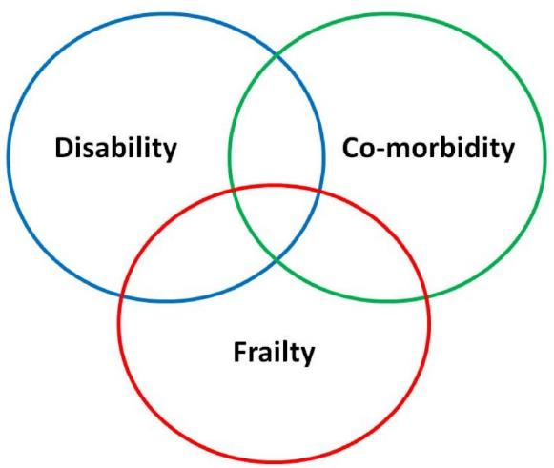
FACTORS AFFECTING DISABILITIES
Reaching Out. Touching Lives. Adding Value!

Slide 18
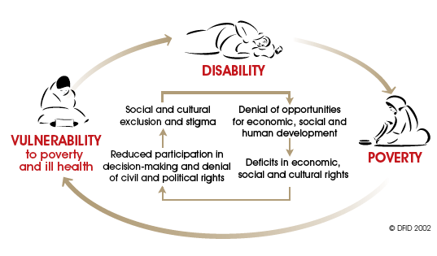
THE DISABILITY CYCLE
Reaching Out. Touching Lives. Adding Value!

Slide 19
TYPES OF DISABILITIES
Disabilities vary from the physical to mental impairments that can hamper or reduce a person's ability to carry out normal day to day activities.
"Disabilities" can also be broken down into a number of broad sub-categories.
Reaching Out. Touching Lives. Adding Value!

Slide 20
CLASSIFICATION OF DISABILITIES - 1
Mobility and Physical Impairments
Spinal Cord Injury
Head Injuries
Vision Impairment
Loss of, or Limitations in, Hearing
Reaching Out. Touching Lives. Adding Value!

Slide 21
CLASSIFICATION OF DISABILITIES - 2
Cognitive or Learning Disabilities
Psychological Disorders
Invisible Disabilities
Developmental Disability
Neuro-Developmental Disabilities
Reaching Out. Touching Lives. Adding Value!

Slide 22
CLASSIFICATION OF DISABILITIES - 3
That unique group of caused by:
Accident
Sudden Lifestyle Changes
Loss of job, spouse (Death, Divorce) or child and Early retirement
Old Age
Reaching Out. Touching Lives. Adding Value!

Slide 23
CLASSIFICATION OF DISABILITIES - 4
Those caused by Natural Disasters and Emergency Situations:
Refugees
Conflict Affected Persons
(Post Traumatic Stress Disorder - PTSD)
Reaching Out. Touching Lives. Adding Value!

Slide 24
DEVELOPMENTAL DISABILITY
A disability that;
Is manifested before the person reaches twenty-two (22) years of age.
Constitutes a substantial disability to the affected individual.
Is attributable to mental retardation or related conditions.
Reaching Out. Touching Lives. Adding Value!

Slide 25
DEVELOPMENTAL DISABILITY - 2
Often referred to by doctors as a “Developmental Delay“, a euphemistic term which can be misleading because, in reality, a delayed gratification is totally different from having NO gratification at all!
Reaching Out. Touching Lives. Adding Value!

Slide 26
NEURO-DEVELOPMENTAL DISABILITIES
Four main types:
Nervous system disabilities,
Sensory related disabilities,
Metabolic disabilities and
Degenerative disorders.
Reaching Out. Touching Lives. Adding Value!

Slide 27
NEURO-DISABILITIES
Attention Deficit Hyperactivity Disorder (ADHD)
Autism
Cerebral Palsy
Bipolar Disorder
Reaching Out. Touching Lives. Adding Value!

Slide 28
NEURO-DISABILITIES
Dyslexia
Dyscalculia
Down Syndrome
Degenerative Disorders
Reaching Out. Touching Lives. Adding Value!

Slide 29
ISSUES IN MANAGEMENT
The Stigma
The Fears
The Reality
Reaching Out. Touching Lives. Adding Value!

Slide 30
CONSEQUENCES OF STIGMA
Denial of the child.
Neglect.
Social isolation.
Child abandonment.
Infanticide.
Reaching Out. Touching Lives. Adding Value!

Slide 31
CONSEQUENCES OF FEAR
A sense of inadequacy.
Depression (often maternal).
Drastic reduction in family income.
Child and spousal abuse (often emotional).
Reaching Out. Touching Lives. Adding Value!

Slide 32
THE REALITY
No known cure or quick fixes.
Neither contagious nor infectious
Care is multi-disciplinary.
Process of care is long and complex.
Lack of a credible data base
Limited knowledge about disability
Limited management options
Reaching Out. Touching Lives. Adding Value!

Slide 33
DENIAL
A refusal or unwillingness to accept something or to accept reality.
- Example: A wife who cannot cope with and won't admit that her husband is either abusing or has left her.
Reaching Out. Touching Lives. Adding Value!

Slide 34
DENIAL - 2
We can be in denial about anything that makes us feel vulnerable or threatens our sense of control, such as:
an illness, addiction, eating disorder,
personal violence, financial problems or relationship conflicts.
We can also be in denial about something happening to us or someone else.
Reaching Out. Touching Lives. Adding Value!

Slide 35
THE DEVELOPING BRAIN
Critical Periods of Brain growth
1 month – neural tube
4th month – All the lobes and major divisions complete
1 year post-natal – 2/3 adult size
2 years age – 75% adult size
5 years – 90% adult size
Potential for Neurogenesis [new brain cell formation] (peaks in utero) and Synaptogenesis [new connection formation] (peaks by 5 years) continues throughout life
Reaching Out. Touching Lives. Adding Value!

Slide 36
DELAYED DIAGNOSIS
Reaching Out. Touching Lives. Adding Value!

Slide 37
THE DISABILITY JOURNEY
Ignorance
Pity
Care
Friendship
Co-Labourers
Reaching Out. Touching Lives. Adding Value!

Slide 38
EARLY
Happening or done before the usual or expected time.
Belonging or happening near the beginning of a particular period.
Before the usual or expected time.
Near the beginning of a particular time or period.
Reaching Out. Touching Lives. Adding Value!

Slide 39
INTERVENTION
The action or process of intervening.
Interference by an individual in another's affairs.
Synonyms: involvement, intercession, interceding, interposition
Action taken to improve a medical disorder.
Reaching Out. Touching Lives. Adding Value!

Slide 40
ACCEPTANCE
The action of consenting to receive or undertake something offered
The process or fact of being received as adequate, valid or suitable
Synonyms:
Welcome; Embrace; Adopt
Reaching Out. Touching Lives. Adding Value!

Slide 41
DISCLOSURE
The action of making new or secret information known.
A fact, especially a secret, that is made known.
Reaching Out. Touching Lives. Adding Value!

Slide 42
INCLUSION
The action or state of including or of being included within a group or structure.
Synonyms: incorporation, addition, insertion, introduction
Reaching Out. Touching Lives. Adding Value!

Slide 43
WHO IS TO BE INCLUDED
The Affected child – Parents, siblings, extended family members and the larger community
Parents – Other family members (Parents, siblings etc), friends, colleagues and the larger community
Siblings – Friends, school mates and the larger community
Reaching Out. Touching Lives. Adding Value!

Slide 44
INCLUSION HOW DO WE GO ABOUT IT
As Individuals;
Get knowledge
Build own capacity
Change mind-set about disability
See beyond the disability
Build a relationship
Become a partner in the disability journey
Reaching Out. Touching Lives. Adding Value!

Slide 45
INCLUSION HOW DO WE GO ABOUT IT
The Affected Child;
Every child can learn, but some learn differently (faster or slower than normal)
Ensure they are ready for Inclusion (Attainment of a minimum level of Independent Living)
Prepare an inclusive learning environment (Access etc)
Provide Special needs Teachers
Prepare other teachers/staff and students for inclusion
Change the mind-set of the entire school population about disability (PTA and Students)
Reaching Out. Touching Lives. Adding Value!

Slide 46
INCLUSION HOW DO WE GO ABOUT IT
As an organisation;
Create access – Parking Space, Ramps, Extra wide doors and passages, Disable-friendly spaces (Toilets, recreational areas etc)
Build staff capacity on disability
Identify and celebrate staff members who either have a disability or children with special needs
Advertise your disable friendly status
Develop a disabled friendly CSR policy
Reaching Out. Touching Lives. Adding Value!

Slide 47
MANAGEMENT
A MULTI DISCIPLINARY
APPROACH
Reaching Out. Touching Lives. Adding Value!

Slide 48
TREATMENT/MANAGEMENT
Several areas of functioning are affected and as a result, there is a requirement for several disciplines to be involved in managing the condition
Best to have a pediatrician coordinate the activities of the multi-disciplinary care team.
Reaching Out. Touching Lives. Adding Value!

Slide 49
TREATMENT (CONTN’D)
Coordinated Care: The complex nature of childhood disabilities require that a team of specialists work together under the coordination of a pediatrician for effective management.
Reaching Out. Touching Lives. Adding Value!

Slide 50
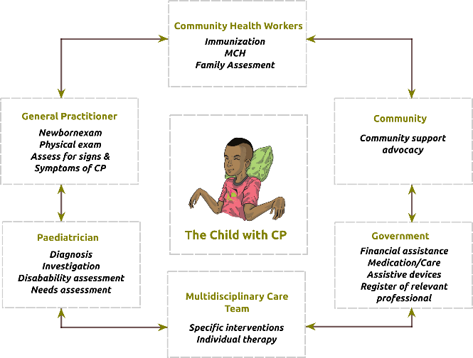
REFERRAL AND COORDINATED CARE PATHWAY
Reaching Out. Touching Lives. Adding Value!

Slide 51
NEED TO CHANGE THE NEGATIVE
MINDSET ABOUT DISABILITIES
Disability management is not just about the child
All disabilities should not be treated alike
The disabled, especially children, thrive better in inclusive societies, i.e at home with family and in inclusive schools
Advocacy for the less privileged goes way beyond special homes and schools
Reaching Out. Touching Lives. Adding Value!

Slide 52
CONCLUSION
Developmental Disabilities are neither infectious nor contagious.
Most Developmental Disabilities have no cure but management options exist.
Over 60% of children with Developmental Disabilities, even when they are non-verbal, have average to above average intelligence.
Reaching Out. Touching Lives. Adding Value!

Slide 53
CONCLUSION
With early intervention, inclusion and assistive technology children living with disabilities can learn new ways of accomplishing tasks that challenge them.
For things to get better, the current mindset about disability and disability management in Nigeria must change.
Reaching Out. Touching Lives. Adding Value!

Slide 54
THE WAY FORWARD
Get Counselling
Build own Capacity about Disability
Join and Help Form Parents Groups
Become Advocates/Volunteers
Visit Special Homes/Schools
Befriend someone who has a disability:
Just say HELLO!
Reaching Out. Touching Lives. Adding Value!

Slide 55
DISABILITY
IS
REAL
Reaching Out. Touching Lives. Adding Value!

Slide 56
IT IS A
MIND THING
Reaching Out. Touching Lives. Adding Value!

Slide 57
There’s Ability
in
Disability
Reaching Out. Touching Lives. Adding Value!

Slide 58
That Special Person in your life is there for a purpose
So, Find it, Nurture it and Start Celebrating it!
Reaching Out. Touching Lives. Adding Value!

Slide 59
THANK YOU FOR YOUR ATTENTION
Reaching Out. Touching Lives. Adding Value!

